Slide 1
How to upload assignments on google classroom
Let begin !

Slide 2

About Google Classroom ?
You can use Classroom in your school to streamline assignments, boost collaboration, and foster communication. Classroom is available on the web or by mobile app. You can use Classroom with many tools that you already use, such as Gmail, Google Docs, and Google Calendar.

Slide 3
How to upload your assignment on classroom -
Firstly , you can download the app from playstore , OR you sign in into the classroom via web , using this link - https://classroom.google.com/

Slide 4
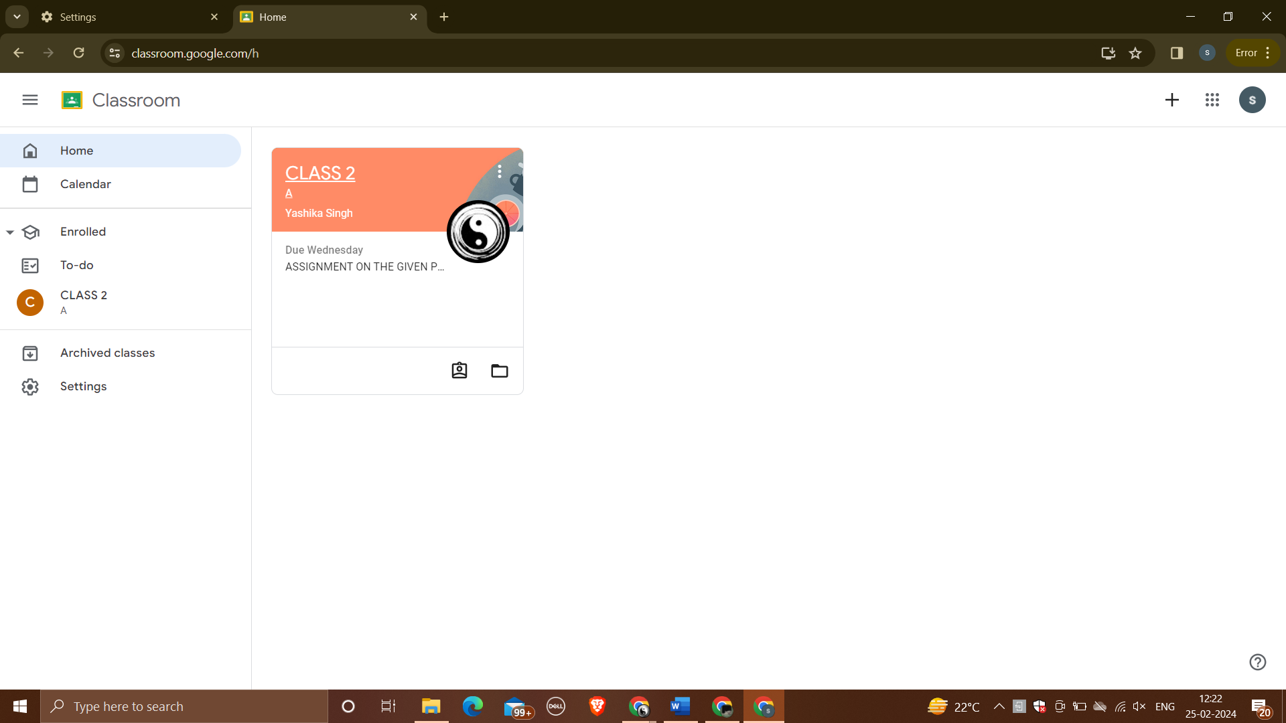

Firstly , open your google classroom , you will be able to see what classes ot streams you are joined in

Slide 5
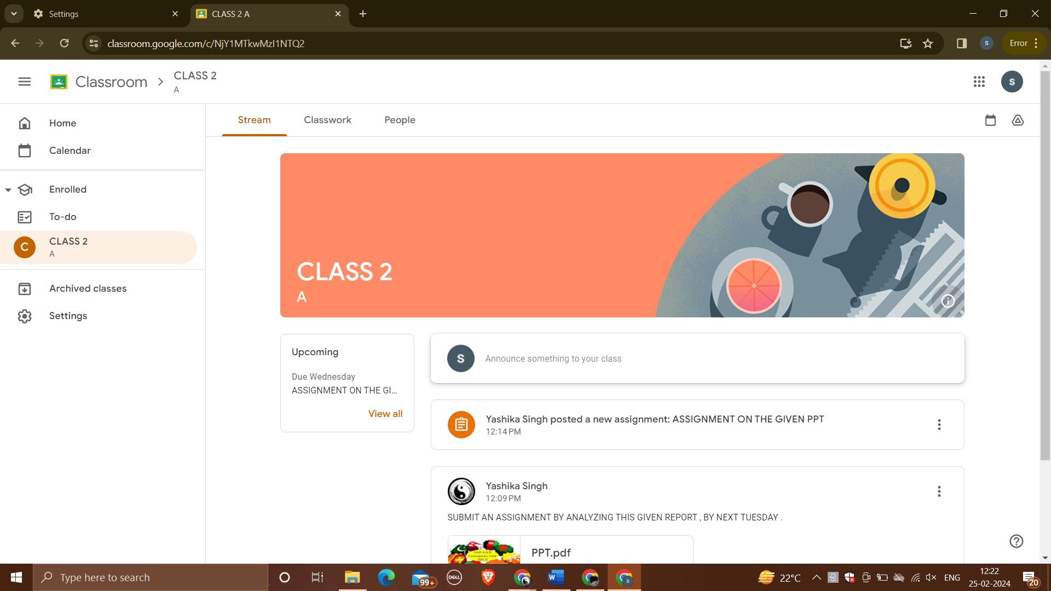

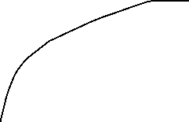
Open your class/stream

Slide 6
You can check your given assignment in two ways

Slide 7
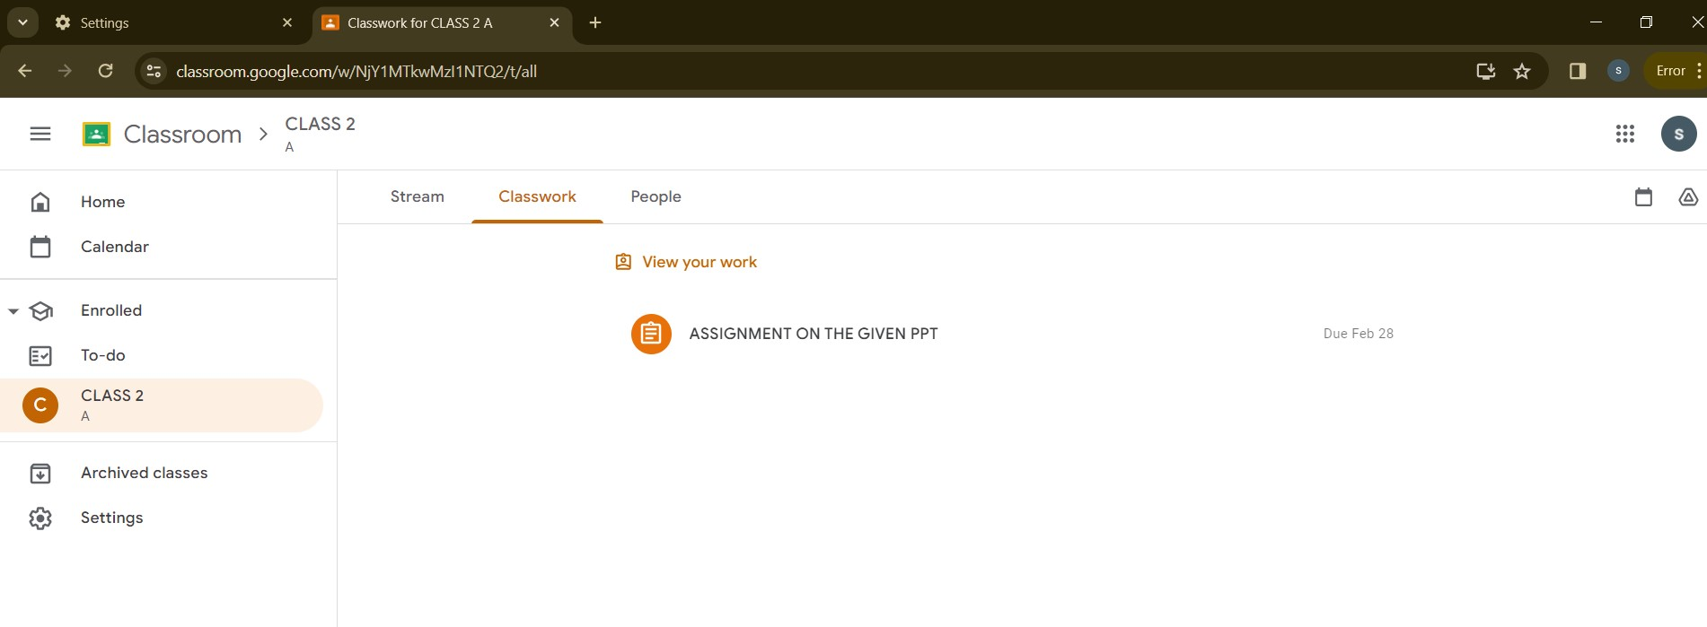




Firstly
You can go to these , above three options and CLICK ON classwork to check what is assigned to you by your teacher .
You can also see the DUE DATE , of when the work has to be submitted

Slide 8
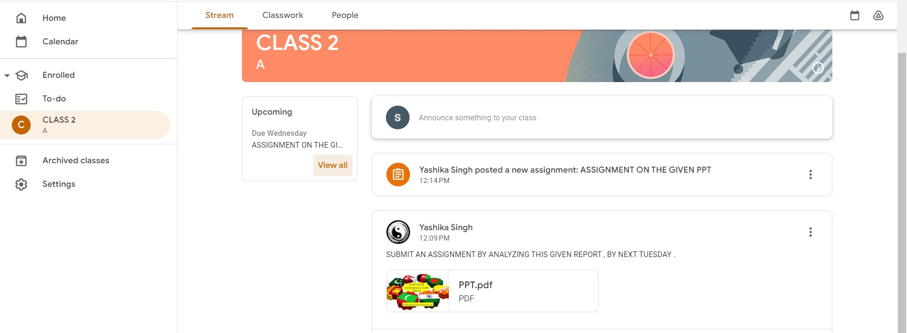


Second way is
You can go to upcoming and see what is , ASSIGNED , WHAT IS MISSING AND WHAT IS DONE -

Slide 9
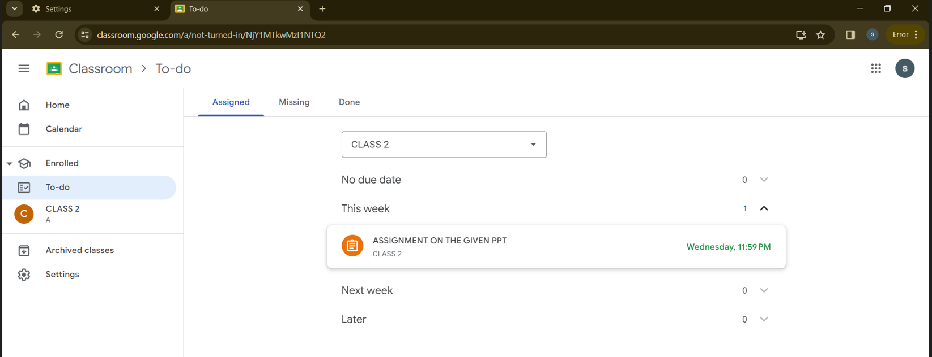

HERE YOU CLICK ON THIS ASSIGNMENT AND CHECK THE INSTRUCTIONS

Slide 10
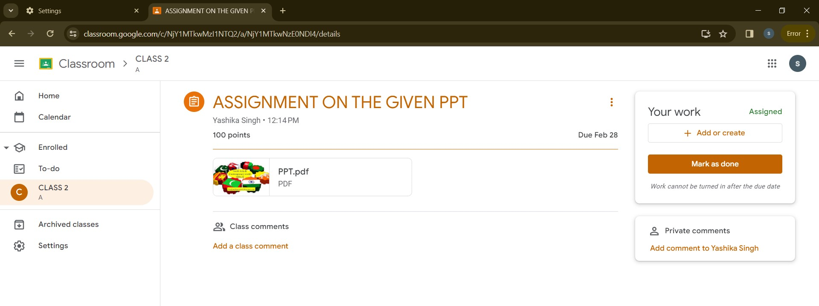




HERE IS AN OPTION TO –
TO ADD A CLASS COMMENT IF YOU WISH TO ,
THEN OPTION TO ADD YOUR ASSIGNMENT

Slide 11
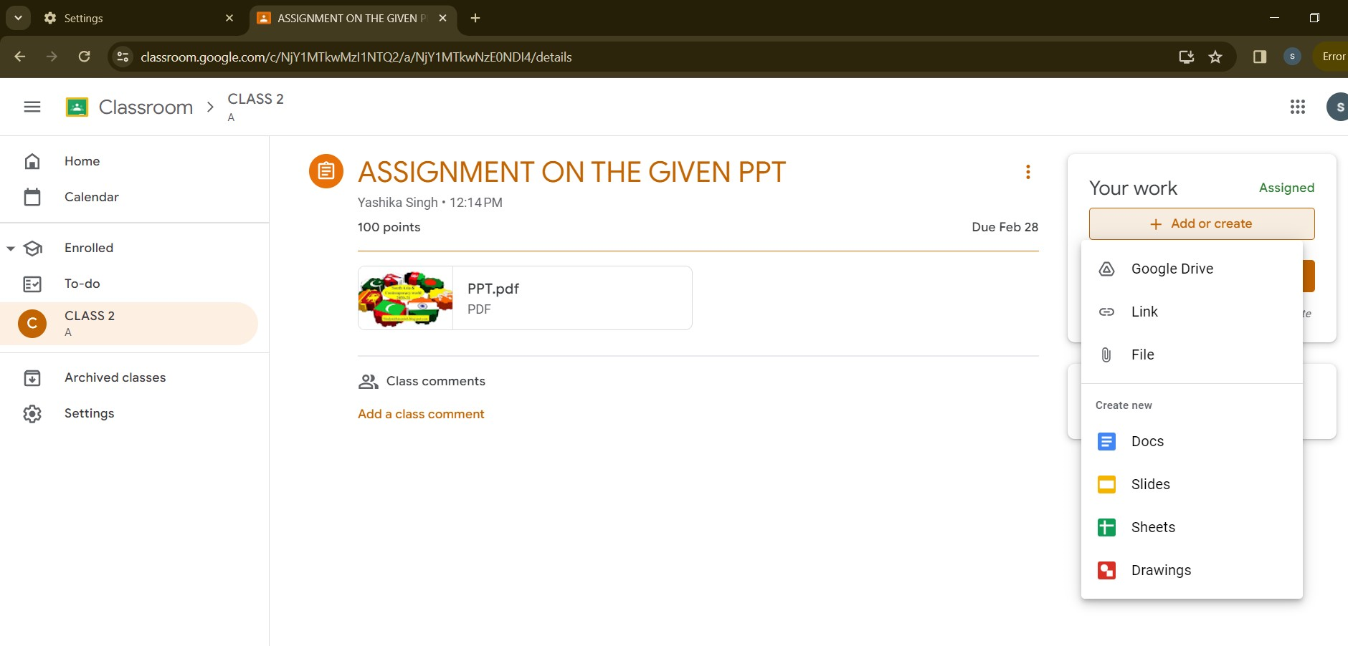


YOU HAVE SEVERAL OPTIONS TO UPLOAD YOUR WORK , THESE ARE AS FOLLOWS

Slide 12
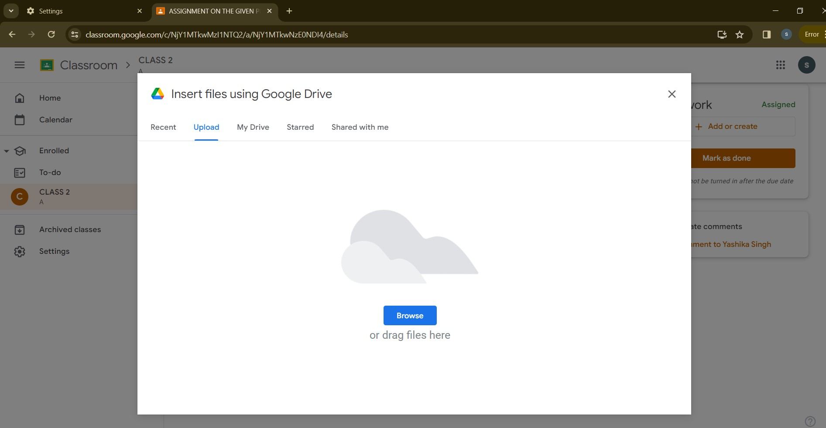


HERE YOU CAN CHOOSE THE FILE FROM THE DEVICE ITSELF , OR THE DRIVE , WHATEVER FEELS EASY TO DO -

Slide 13
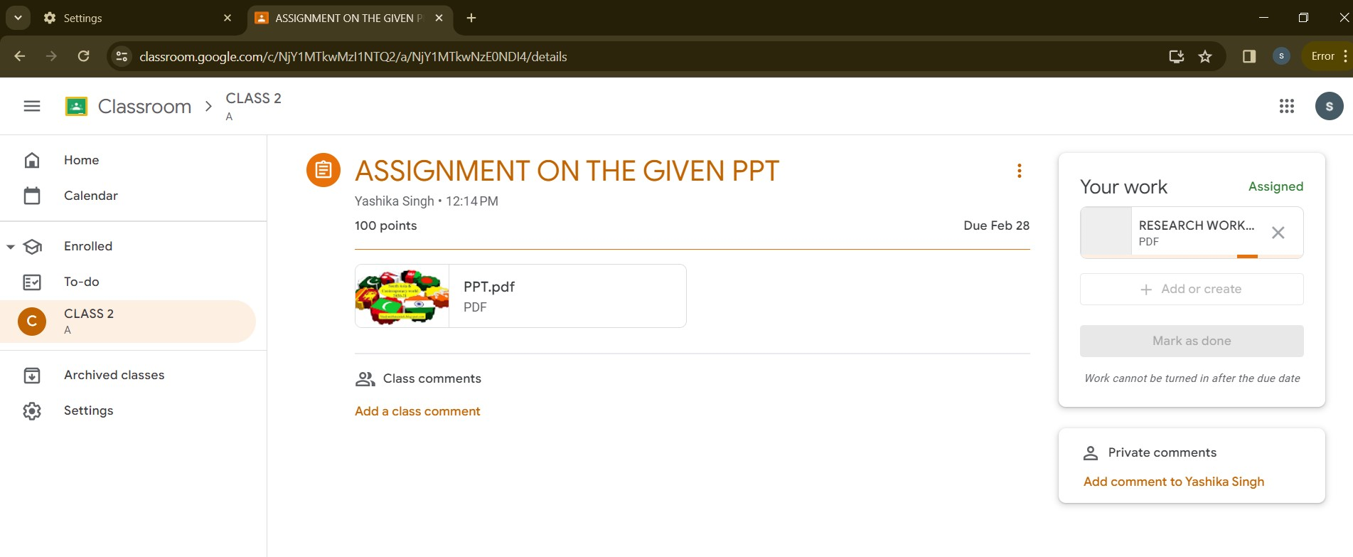


HERE NOW I HAVE UPLOADED THE WORK , BY SELECTING THE DESIRED FILE AS CHOSEN IN THE STEP BEFORE -

Slide 14
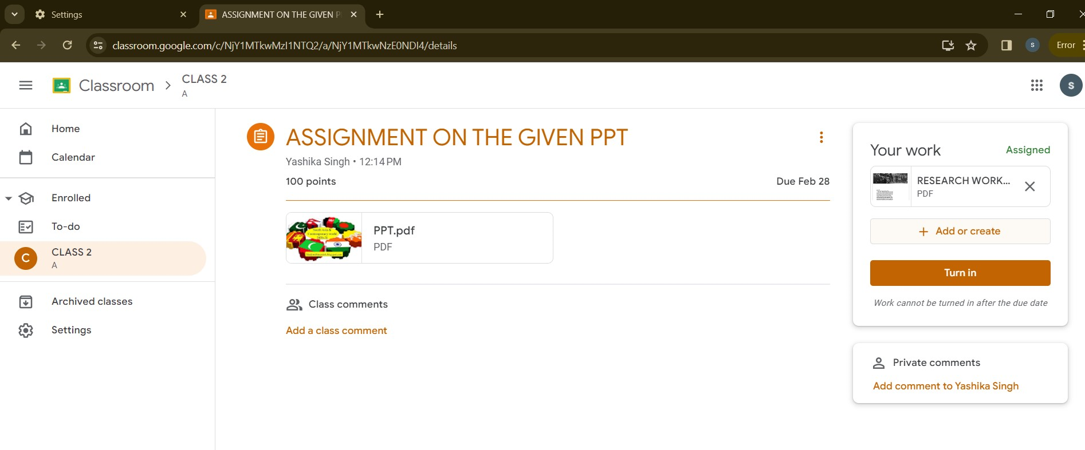
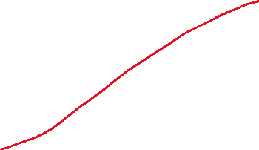



WHEN ITS UPLOADED IT WILL BE LIKE THIS,
YOU CAN FURTHER ADD MORE ASSIGNMENT IF REQUIRED OR NEEDED ,

Slide 15


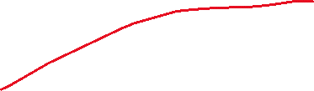
THEN YOU CAN TURN IN AND FINALLY CAN SUBMIT YOUR WORK

Slide 16
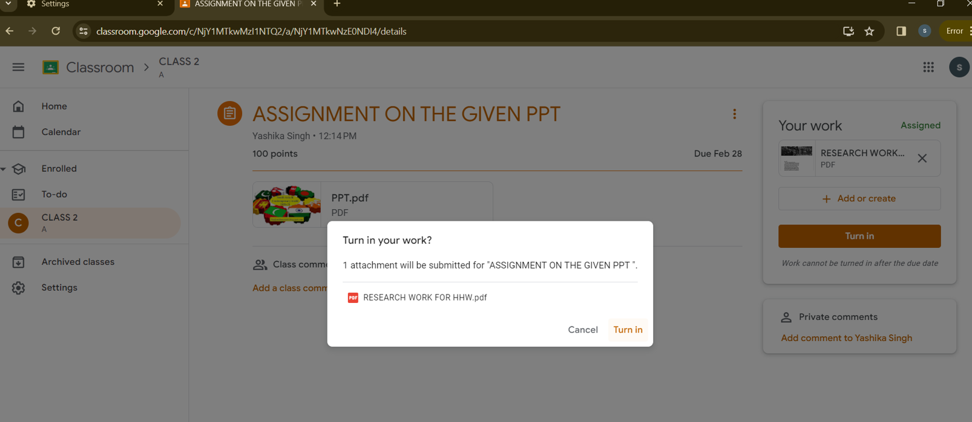

NOW YOU CAN FINALLY , SUBMIT IT AND CONFIRM SUBMITITNG

Slide 17
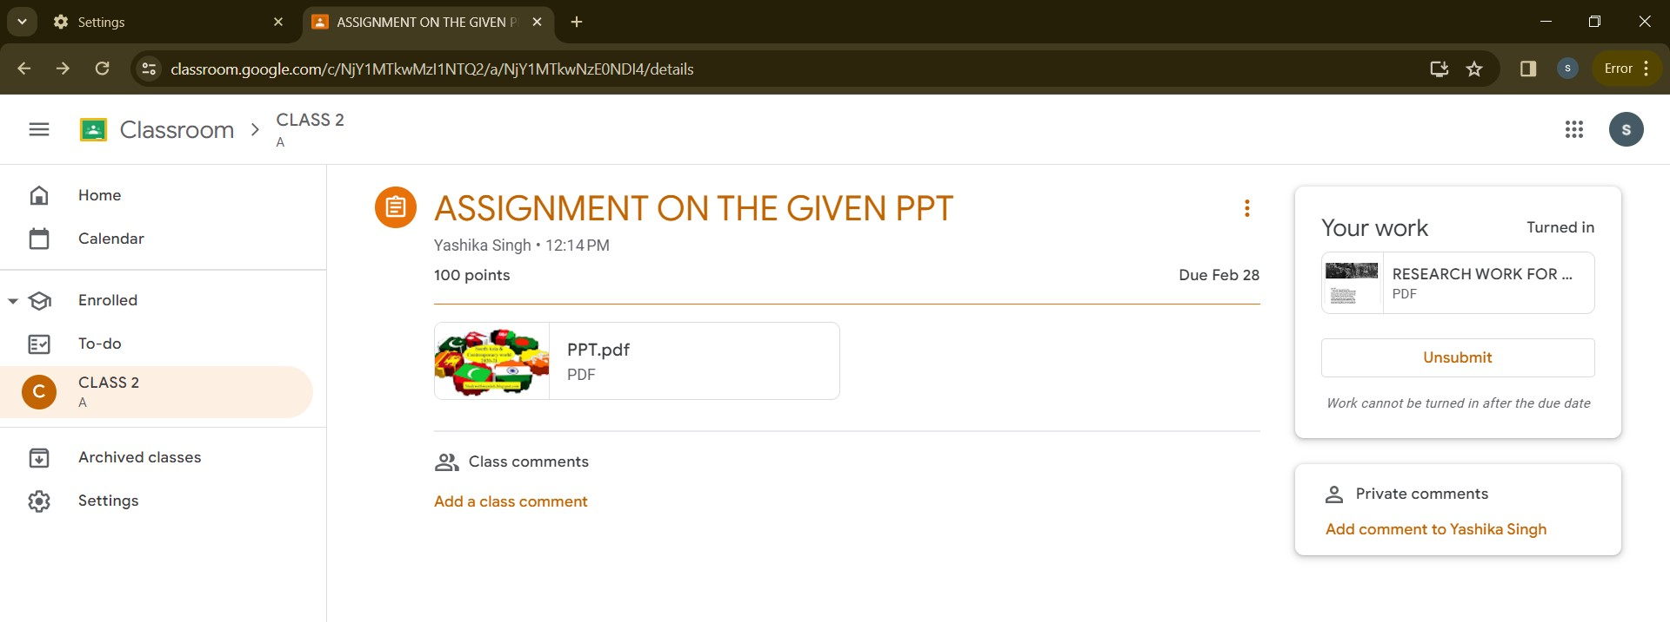

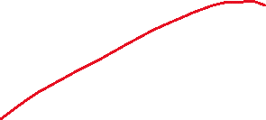
NOW ITS SUBMITTED , YOU HAVE THE OPTION TO UNSUBMIT IT BUT PLEASE NOTE , YOU CANT UPLOAD YOUR ASSIGNMENT AFTER THE DUE DATE IS GONE

Slide 18
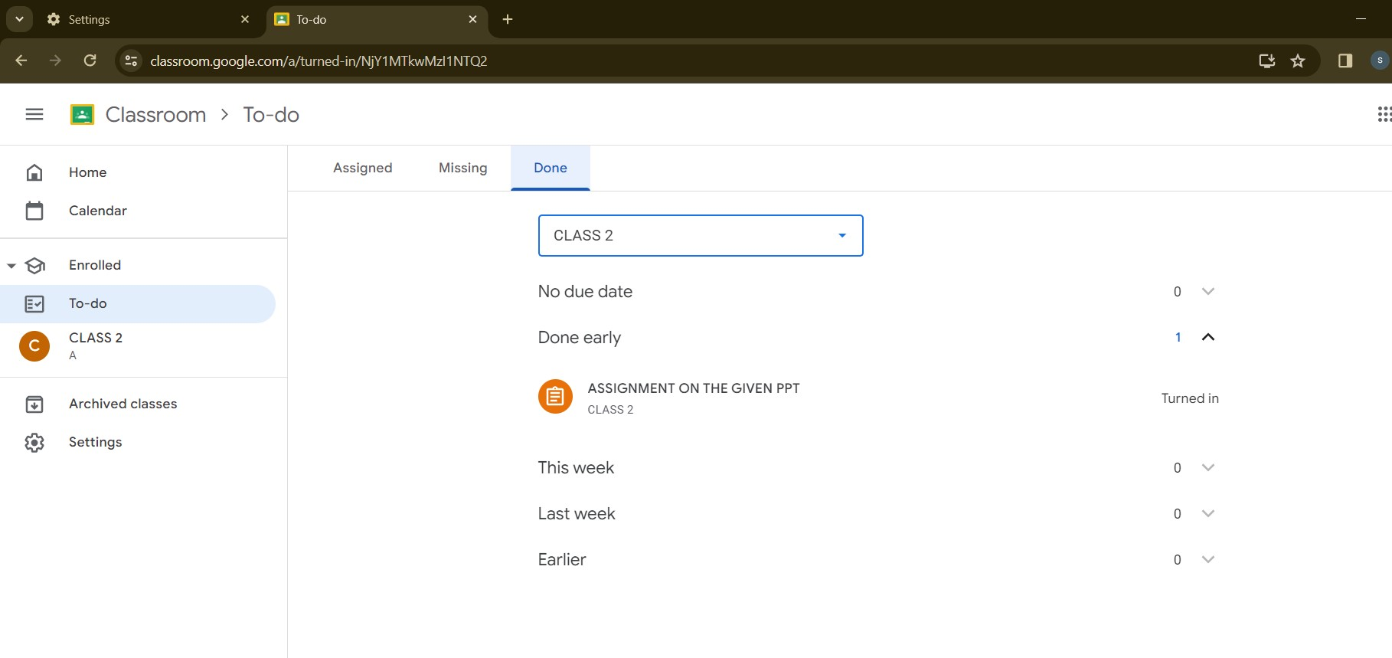




NOW YOU CAN CHECK FROM YOUR TO DO LIST , WHAT WORK IS DONE AND WHATS MISSING .

Slide 19
THANK YOU !
AND IT IS DONE!

